Slide 1
HOUSE OF FLAGS
by
AY Architects

Slide 2
DATEN
House of flags
AY Architects
25.07. – 12.09.2012
Parliament Square, London

Slide 3
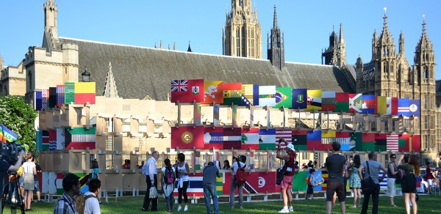

Slide 4
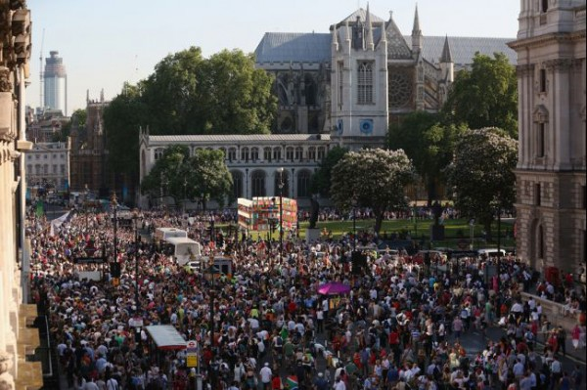

Slide 5
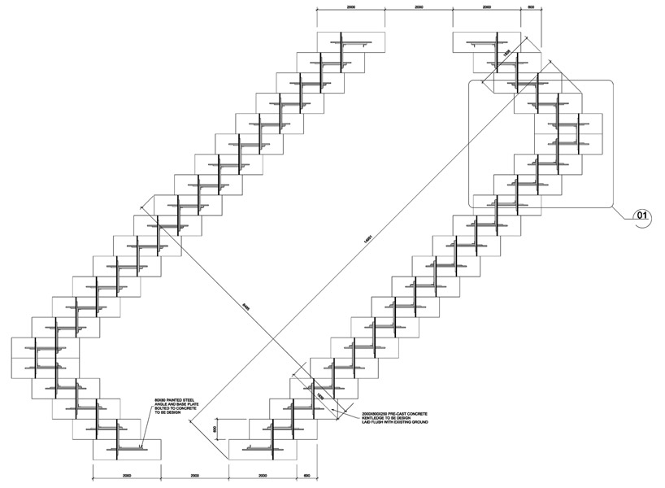

Slide 6
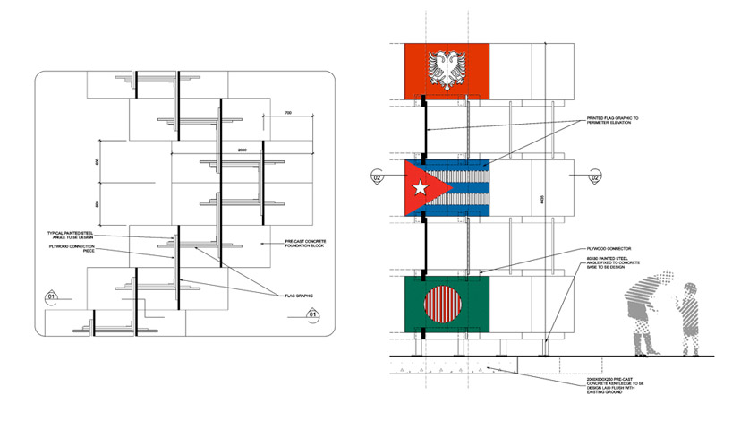

Slide 7
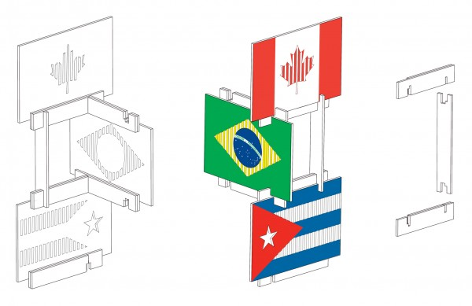

Slide 8
